Slide 1
Academic Affairs/West Campus Investments
AUGUST 29, 2022
Presented by Provost Carl Lejuez to the University Senate

Slide 2
VP03 Reporting Units
Academic Units | College of Arts and Sciences College of Engineering and Applied Sciences College of Business Graduate School Library School of Communication and Journalism School of Marine and Atmospheric Sciences School of Professional Education Southampton
Administrative Units | Division of Undergraduate Education Division of Enrollment Management International Academic Programs and Services
Centers and Institutes | Alda Center Bio Online BPE Center for Biotechnology CIDER IACS ICB&DD ICTE IMS | iSTEM JPSI Laufer Life Sciences Complex SCAN Center Simons Staller TBI YITP

Slide 3
Overview
  A meaningful level of faculty hiring for AY23-24 due in part to support from new SUNY funding for faculty hiring
  We continue to have work to do to support staff hiring
  Must be considered in context of unfunded mandatory costs and other fiscal challenges

Slide 4
Academic Year 2022/2023* Added/Lost TT/T Faculty
 | TT/T Faculty for Academic Year 2022-2023 (AY22/23)
 | AY22/23 Added | AY22/23 Lost | AY22/23 Overall Added/Lost
CAS | +12.0 | -22.0 | -10.0
CEAS | +5.0 | -7.0 | -2.0
SOMAS | +1.25 | -2.0 | -0.75
Business | +2.0 | -2.0 | 0.0
SOCJ | +2.0 | -1.0 | +1.0
Library | +1.0 | -2.0 | -1.0
Open | +0.0 | 0.0 | 0.0
Total | +23.25 | -36.0 | -12.75
* AY is calculated from 10/2-10/1 to allow for straggling attrition

Slide 5
Academic Year* Added/Lost TT/T Faculty (Estimated)
 | TT/T Faculty for Academic Year 2023-2024 (AY23/24)
 | Approved to be Added AY23/24 | AY23/24 Likely Lost | AY23/24 Overall Added**/ Lost***
CAS | +23.0 | -17.0 | +6.0
CEAS | +8.0 | -6.5 | +1.5
SOMAS | +2.0 | -1.5 | +0.5
Business | +1.0 | -1.0 | 0.0
SOCJ | +1.0 | -0.5 | +0.5
Library | +3.0 | -0.5 | +2.5
Open | +3.0 | 0.0 | +3.0
Total | +41.0 | -27.0 | +14.0
* AY is calculated from 10/2-10/1 to allow for straggling attrition
** Estimate using PY attrition as estimate ~4% total faculty
*** Estimate using ATR process approvals and other estimated additions

Slide 6
Estimated Gain and Loss of TT/T Faculty

Slide 7
List of TT/T Faculty Hire Authorizations by School/College on West Campus

Slide 8
A&S
Department | Concentration | Rank
Art | Digital Art | Professor
Asian & Asian American | Chinese in Multilingual/Global Settings | Assistant Professor
Humanities Cluster | Intersection of Liberal Arts and Technology | Assistant Professor
Philosophy* | Islamic Philosophy/History of Philosophy | Assistant Professor
Women’s, Gender, & Sexuality | Digital Black Feminism/AI | Assistant Professor
Writing & Rhetoric | Health and Medical Rhetoric | Assistant Professor
Anthropology** | Turkana Basin Institute | Assistant Professor
Changing Systems of Power Cluster | Director, Global Citizenship Professor (endowed) | Professor
Economics | Applied Economics | Professor
Linguistics (Partner Accommodation)* | TESOL/Language Acquisition | Assistant Professor
Political Science | Challenges to Democracy | Assistant Professor
Psychology | Health and Development across Lifespan | Assistant Professor
Sociology | Sociology of Global Health | Assistant Professor
Biochemistry | Drug Diagnosis and Discovery | Assistant Professor
Chemistry | Health Disparities/Energy & Environment/AI | Assistant Professor
Ecology & Evolution* | Biodiversity Data Science | Assistant Professor
Mathematics* | Complex Differential Geometry | Associate Professor
Neurobiology | Computational Neurobiology | Assistant Professor
Physics & Astronomy | Experimental High Energy Physics | Assistant Professor
Physics & Astronomy** | Yang Institute for Theoretical Physics | Assistant Professor
Other
+1 Rollover search in Physics & Astronomy (Assistant Prof)
+1 delayed hire in Economics (Full Prof) for Fall 2023
+1 New arrival in History (Assistant Prof) for Fall 2023
* Conversion of existing Non T/TT line
**Sits outside of A&S Budget

Slide 9
All Other TT/T Hires
Department | Concentration | Rank
CEAS
Applied Mathematics & Statistics | AI/Machine Learning/Data Science | Assistant Professor
Biomedical Engineering | Nanotech/Regenerative Engineering | Associate Professor
Chemical Engineering | Green Synthesis/Processing | Assistant Professor
Civil Engineering | Automated Construction/Robotics | Assistant Professor
Computer Science | Cybersecurity | Associate Professor / Professor
Electrical & Computer Engineering | AI/Machine Learning | Assistant Professor
Materials Science & Chemical Engineering | Energy/Materials Science | Assistant Professor
Mechanical Engineering | Energy Conservation/Harvesting | Assistant Professor
SOMAS
Open across SOMAS Divisions | Climate/Disparities across SOMAS | Assistant Professor
Open and joint with Program in Public Health | Public Health across SOMAS | Assistant Professor
Business
Management | Entrepreneurship | Assistant Professor
SOCJ
Journalism | Journalism | Assistant Professor
Open
Open | AI Institute | Professor
Open | Simons Center | Open Rank
Open | Quantum | Professor
Open | IDEA Fellows (8) | Assistant Professor in 2025
Future Possibilities
Presidential Priorities | Quantum, Aging | Open Rank
Spousal Accommodation | Targeted to Support Hiring | Open

Slide 10
Library
Faculty
2 FTE loss in past year (as well as significant loss in previous years)
1 FTE arriving this year (New Dean)
New hires approved for search
  Associate Librarian and Associate Dean for Collection Strategy & Management
  Assistant Librarian and Head of Cataloging and Metadata Services
  Assistant Librarian and Head of Humanities and Social Sciences
Staff
6.5 FTE loss in past year
4.0 FTE arriving this year
New hires approved for search
  Multimedia Resource Specialist
  Evening Services Supervisor (.5 FTE)
  Overnight services Supervisor (.5 FTE)

Slide 11
NTT and Staff Hires From ATR Process
(Does not include replacements approved during the past year)
CAS
Humanities Inst Business Manager
KPC Office Manager*
KPC Associate Director*
Bassoonist – Lecturer
CEAS
Eng. Support Shops – Machinist
School of Business
Management – Lecturer
SOCJ/Alda Center
Alda Center- Associate Director*
Alda Center – Staff Assistant*
Journalism – Visiting Professor*
Library
Multimedia Resources Specialist
Evening Services Supervisor (.5)
Overnight Services Supervisor (.5)
Graduate School
Director, Marketing & Communications
Senior Assistant Dean, Finance & Administration
Staff Assistant, Finance & Administration
Prog Manager, Prof Development/Training Grants
Director, Office of Student Services
Graduate Student Services Specialist
Undergraduate Education
Lecturers (14) for Class Availability
Assistant Dean for Honors Programs
Associate Vice Provost for Curriculum
Enrollment Management
Financial Aid Administrator
Grad Admissions Coordinator/Recruiter
Global Affairs
Vice Provost*
Laufer Center
Senior Administrative Assistant*
Simons Center
Research Professor (5)*
IMS
Milner Lecturer (3)
Provost
Administrative Assistant
Southampton
Film – Practice Professional Lecturer
Director, Food Education Curriculum*
School of Professional Development
Director Student Services and Records*
Assistant Director Records and Admissions
* Partially or Fully funded by unit through other sources

Slide 12
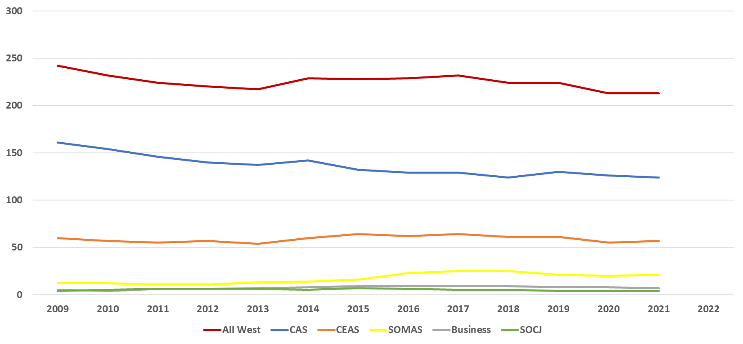
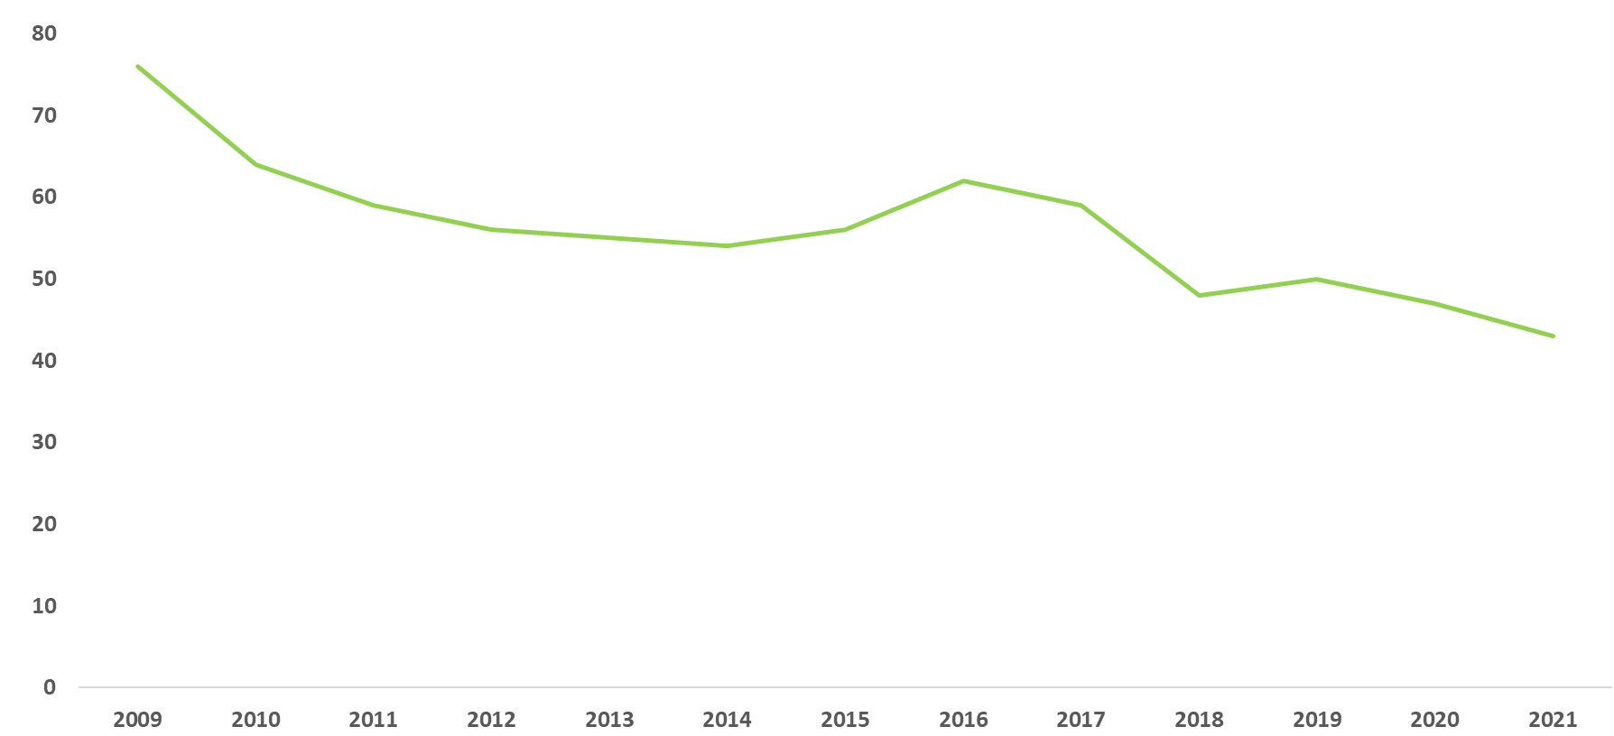
Staff FTE
Within Academic Support Units
Within Schools/Colleges
Libraries

Slide 13
Where are we headed?
Strategy
  Must consider ways to generate new funds
  Strategic hiring in line with Presidential Priorities will be important
Process – Over the next year we will:
  Provide further details on process in our Office
    Full list of authorized hires at https://www.stonybrook.edu/commcms/provost/budget/positions2022-23.php
  Communicate clear messages about what are the factors that underlie decisions
  Work closely with deans and other unit leaders in the decisions we make
  Generate and share more information on historic trends to guide decisions (especially for staff across all units in academic affairs)
    See West Campus Budget Forum presentation - https://www.youtube.com/watch?v=_zGYFMpJykc

Slide 14
Other Updates
Leadership Searches
  Library
  Engineering
  Business
SBU STEM Scholars Program
Graduate School
Strategic Planning/Project REACH
IDEA Fellows
P&T Working Group

Slide 15
Areas of Investment in the HS Schools & Renaissance School of Medicine – East Campus
AUGUST 29, 2022
Presented by Provost Carl Lejuez to the University Senate
standing in for EVP Harold Paz

Slide 16
East Campus Hiring
East Campus hiring investments in the following areas:
  5 in School of Nursing ($425K) - To address faculty:student ratio issue
  2 in School of Social Welfare ($235K) - to also address faculty:student ratio
  2 in Public Health ($315K) - Interdisciplinary faculty related to Climate Change – one jointly with SOMAS and one with RSOM (part of new Masters in Healthcare Administration program)
The Renaissance School of Medicine (Self-Funded) was approved for an additional twenty new tenure/tenure-track faculty
  10 in Basic Science Departments
  5 in the Cancer Center
  5 Clinical Research/Physician Scientists
Dr. Peter Igarashi, newly appointed dean in the Renaissance School of Medicine, will be able to invest existing school resources to address critical institutional priorities including:
    Research
    Education
    Diversity, Equity, Inclusion, and Belonging (DEIB)
    Recruitment/Retention
    Support for key facilities
    Increased medical student scholarship opportunities (matching program with CPMP)

Slide 17
Other Investments/News
Dr. Patrick Lloyd new Dean in the School of Dental Medicine will focus on:
  Recruiting senior level faculty and permanent chairs;
  Supporting research;
  Stabilizing and propeling the Dental Clinic; and
  Expanding the Faculty Practice Plan and dental school Class Size.
SBU Strategic Budget Initiative supporting new Clinical Placement Office
Investments in classroom, learning spaces, and other academic support
Implementation of an enhanced IT infrastructure and desktop computer replacement program in conjunction with SBMIT
Increase staffing in HSC Compliance

